Slide 1
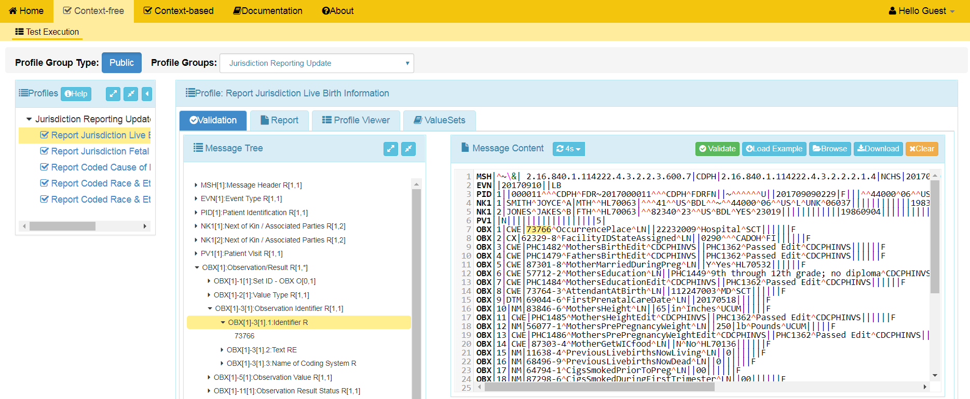
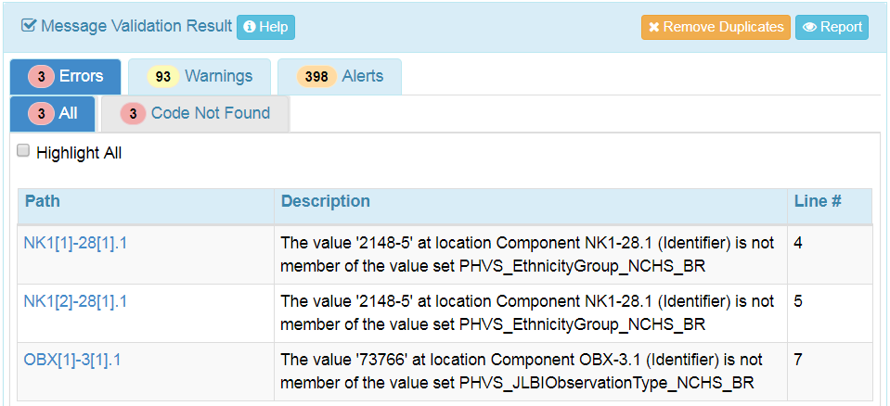
Context-Free – Test Execution
1
2
4
Select HL7 Context-free from the Menu Bar.
Select Profile Group
Load the message into the Message Content window.
3
Select conformance Profile.
5
Click the Validate button to initiate validation of the message.
View the validation results displayed in the Message Validation Result window.
7
Click on the Report button to view the Message Validation Report
6

